Slide 1
Telling the Story of Your Parish

Slide 2
St. Anthony on the Lake
Showcase Your Staff
Finding Interesting Ways to Record Interviews with: staff | parishioners
(Anyone have a good process in place?)

Slide 3
St. Leonard
Photos with captions… …set context… | …have a purpose… …when we post
Show and tell the why of your parish

Slide 4
St. Matthew Oak Creek
Pastor’s Notes Blog
Fresh Material from… …our pastor …our bulletin …conversations with parishioners/staff …events
So Invaluable to Tell the Story

Slide 5
St. John XXIII
Joke of the Day
Breaking up our Mass videos to use… …little segments of homilies …witness talks …incidentals in Mass to tell the story
Get Local with Our Pics to Tell the Story

Slide 6
St. John Vianney
Individual pages for Events
Facebook events (Successes?)
Specific Places
To Easily Direct (to mission trip, parish renewal, events, etc.)
Giving Clear and Simple Paths to access your church

Slide 7
St. James Menomonee Falls
Happy New Year Graphic
For any ask or pitch you make on your social acct, you should have 8 enrichment, things you can use, etc. posts.
We need the beauty of Christ and power of God told in every aspect of our parish

Slide 8
Resurrection Allenton
St. Peter Slinger
St. Lawrence Hartford
BBQ Bible & Beer
Creativity with Titles
Not just inside our parish (with events and telling the story)
Press releases
Tell the story without using churchy words!

Slide 9
Queen of Apostles
Jesus throwing out the peace signs
Find fun ways to say something about our parish
Think creatively
How something might be funny or ignite an emotion
Kudoboard
Create outlets for people to tell the story
Two question form with a QR Code (for an event, on your weekly email, for your mission trip, etc.)

Slide 10
Christ King
Prominence of Serving Others
Best way to engage parishioners
Get them talking
Get them doing
Get them sharing the story through direct service
Be sure to tell the story
Why your parish does it
Why it’s valuable to you/others
Always think about the why

Slide 11
St. Gabriel
The Beauty of Your Parish
Pics of course
But a story too
Don’t let it pass before someone else knows about it.

Slide 12
St. John the Evangelist
Quality of Mass videos
Deliver quality and purpose in our telling of the story
A quality product is a great way to tell the story of your parish

Slide 13
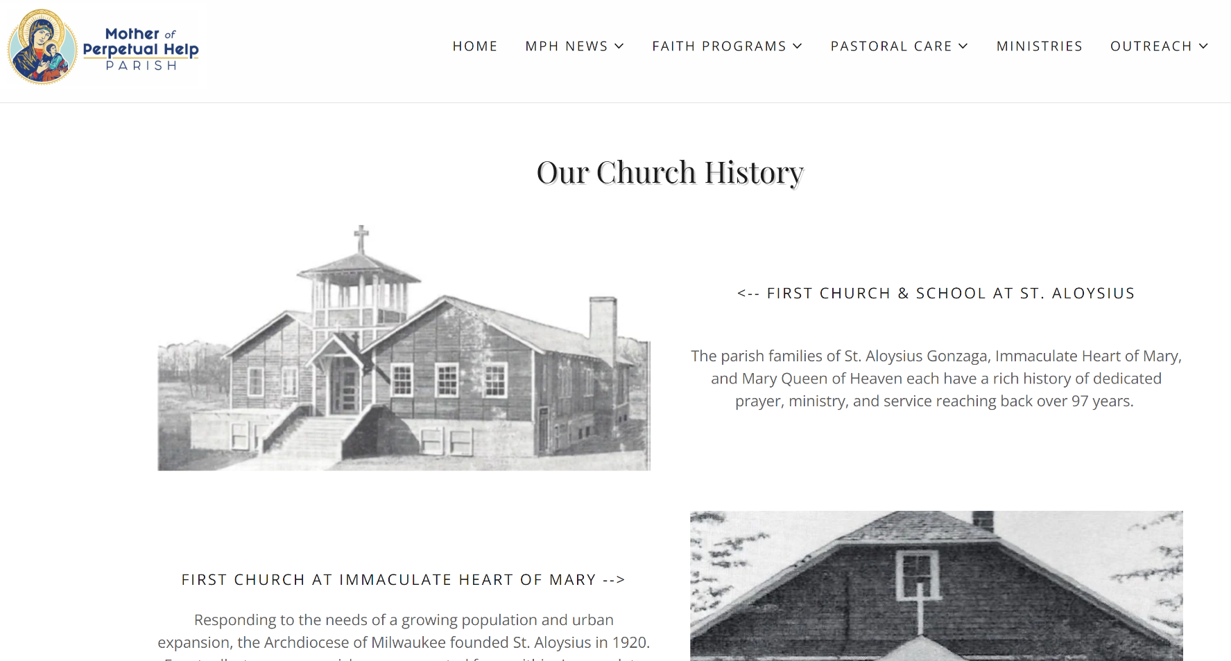
Mother of Perpetual Help
History Page (lots of pics and sharing their recent transition)
Looking to your past
Look to the past to re-share, reminisce and renew something that tells the story today (current issue or reignition of something that went away for a time)

Slide 14
Our Lady of Lourdes
Wednesday Table Reflections
It is easy to record
Remind ministries and parishioners that they can record reflections, witness talks and event recaps that can be put to pictures and make a great way to tell the story

Slide 15
St. Jude
Prayer Network
You are there for others always as a parish
Being responsive and allowing the community to tell the story exactly the way God wants us to do so

Slide 16
How Are You Telling the Story of Your Parish?

