Slide 1
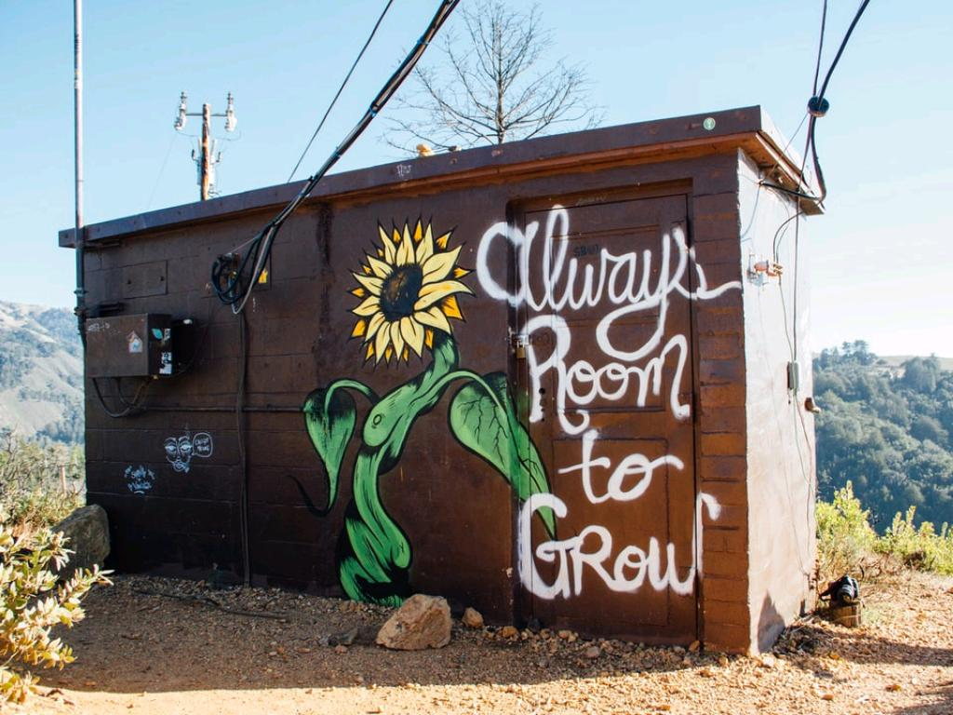
Extending Faith Formation
Using Technology
cc: Kyle Glenn - https://unsplash.com/@kylejglenn?utm_source=haikudeck&utm_medium=referral&utm_campaign=api-credit

Slide 2
I can't fit it all in!
cc: Walt Stoneburner - https://www.flickr.com/photos/8404611@N06

Slide 3
Extend the session
How
What
Who
cc: Aaron Burden - https://unsplash.com/@aaronburden?utm_source=haikudeck&utm_medium=referral&utm_campaign=api-credit

Slide 4
Texting tools
Remind
Flock Note
Parish Database
Not your own...
cc: Becca Tapert - https://unsplash.com/@beccatapert?utm_source=haikudeck&utm_medium=referral&utm_campaign=api-credit

Slide 5
Email & social media...
cc: Frau Hölle - https://www.flickr.com/photos/36154286@N03

Slide 6
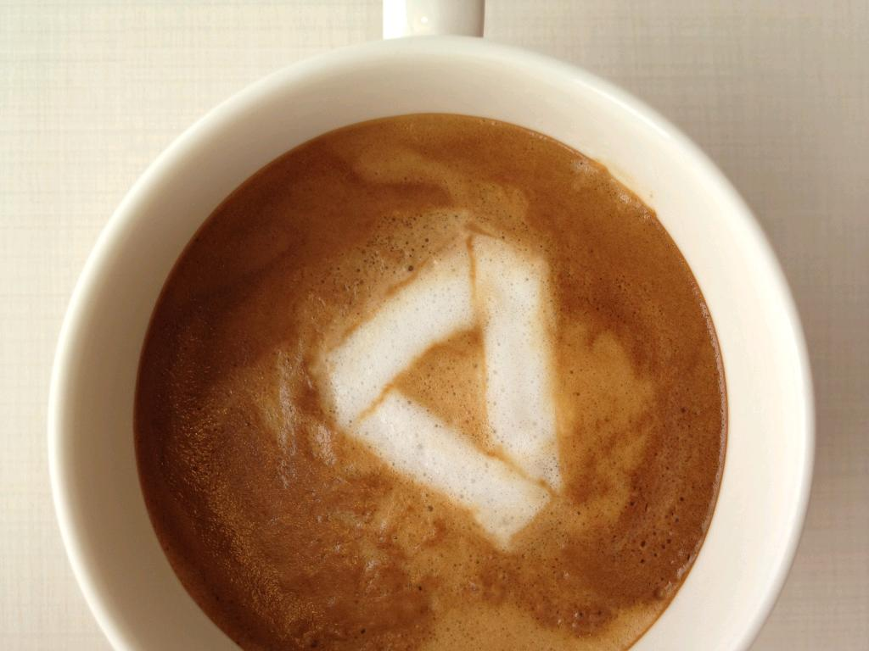
Shared Files
Google Drive (docs, sheets, etc.)
Dropbox
Link to larger documents
cc: yukop - https://www.flickr.com/photos/22322135@N00

Slide 7
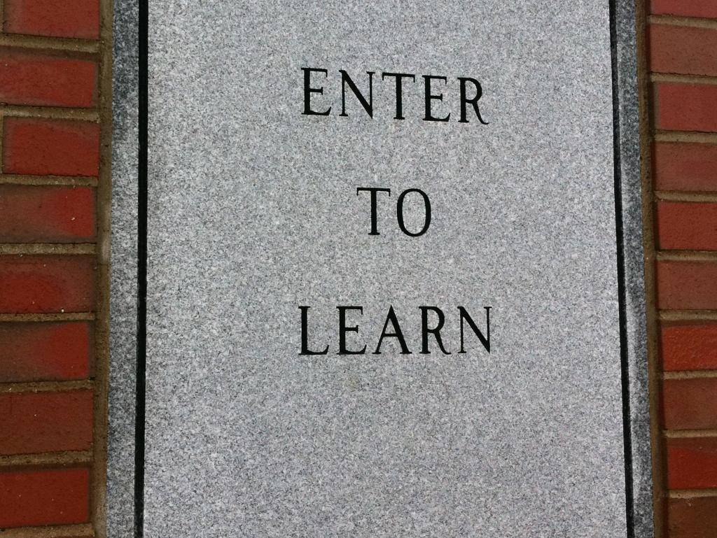
LMS...
Schoology
Canvas
Seesaw
Edmodo
cc: cogdogblog - https://www.flickr.com/photos/37996646802@N01

Slide 8
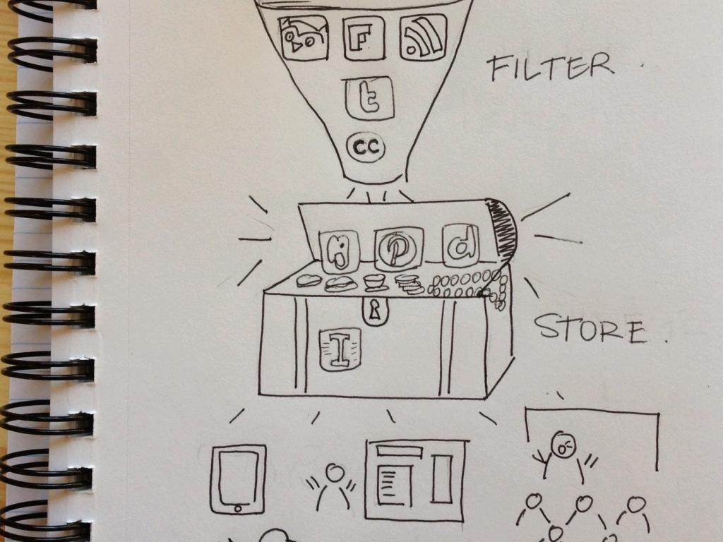
Content is King
cc: *s@lly* - https://www.flickr.com/photos/52926035@N00

Slide 9
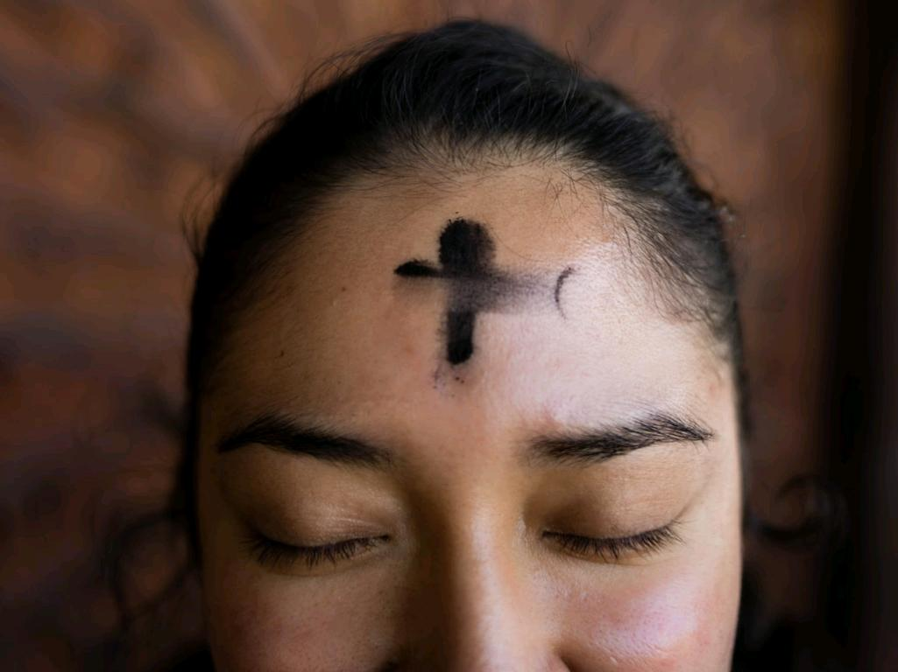
Seasonal
Feast days
Saints
Local events
cc: Annika Gordon - https://unsplash.com/@annikamaria?utm_source=haikudeck&utm_medium=referral&utm_campaign=api-credit

Slide 10
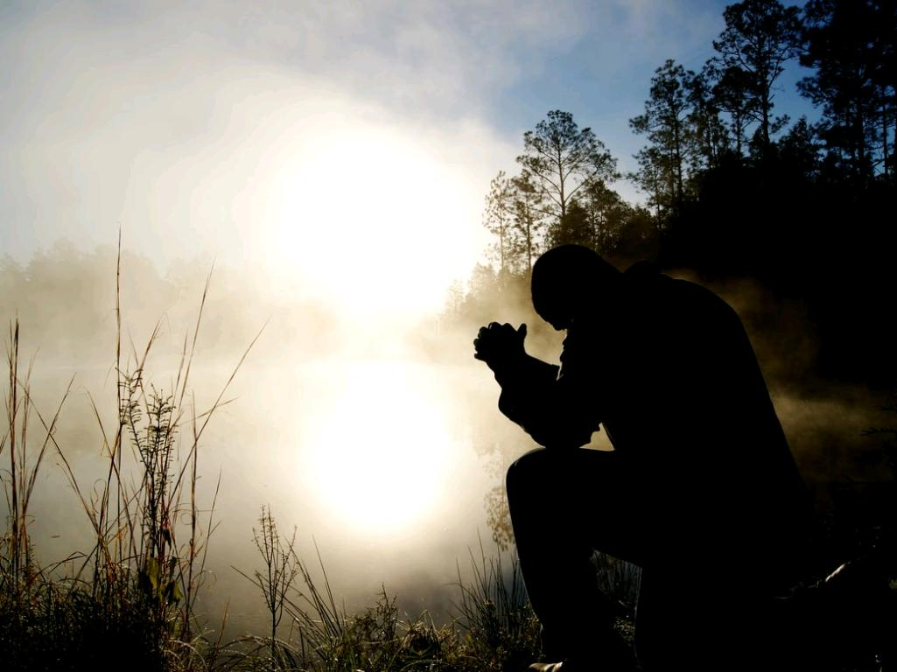
Prayers
Specific intentions
Local/global events
Ways to pray
cc: Aaron Burden - https://unsplash.com/@aaronburden?utm_source=haikudeck&utm_medium=referral&utm_campaign=api-credit

Slide 11
Reminders
Due dates
Upcoming sessions
Special projects
Review of last session
cc: AbsolutVision - https://unsplash.com/@freegraphictoday?utm_source=haikudeck&utm_medium=referral&utm_campaign=api-credit

Slide 12
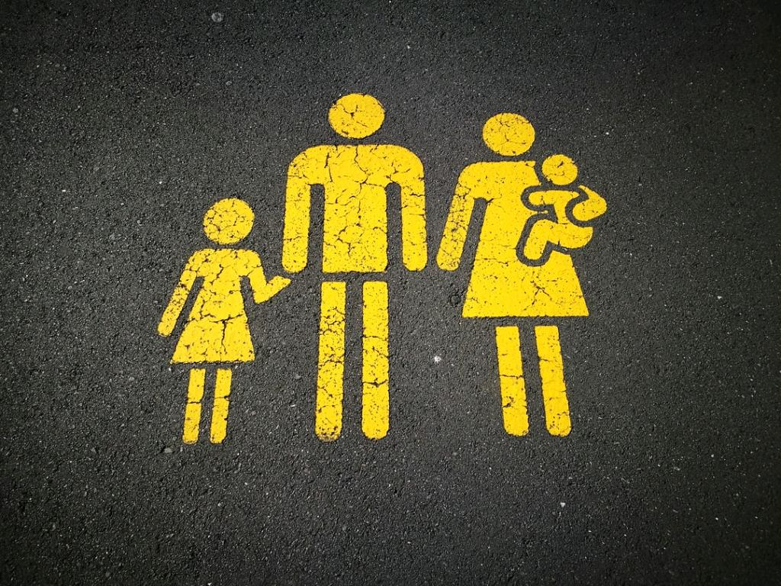
Parent communication
What was covered (Key points)
Additional info
Conversation starters
Catch their kids doing something good…
cc: Sandy Millar - https://unsplash.com/@sandym10?utm_source=haikudeck&utm_medium=referral&utm_campaign=api-credit

Slide 13
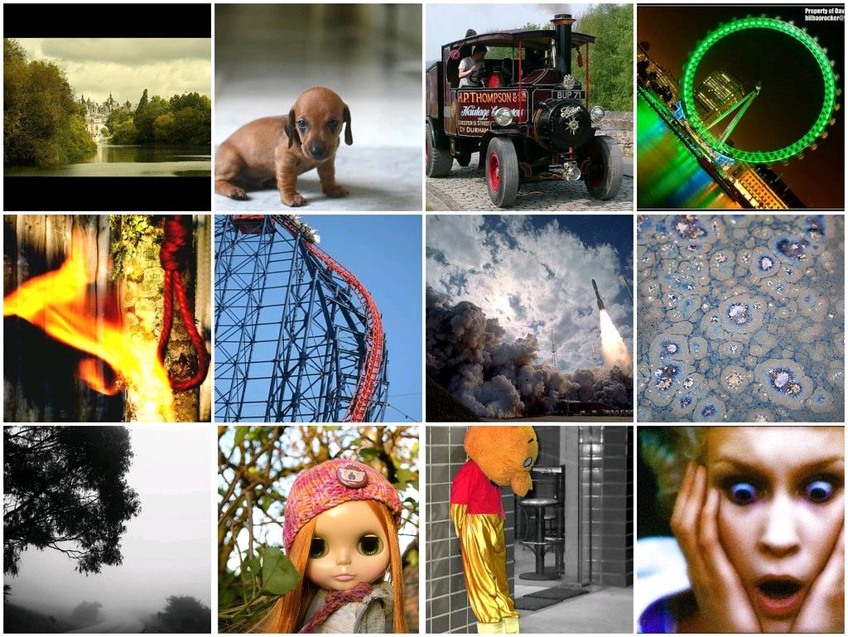
I found this cool...
Video
Meme
Article
Prayer
Website
cc: James Marwood - https://www.flickr.com/photos/30993871@N00

Slide 15
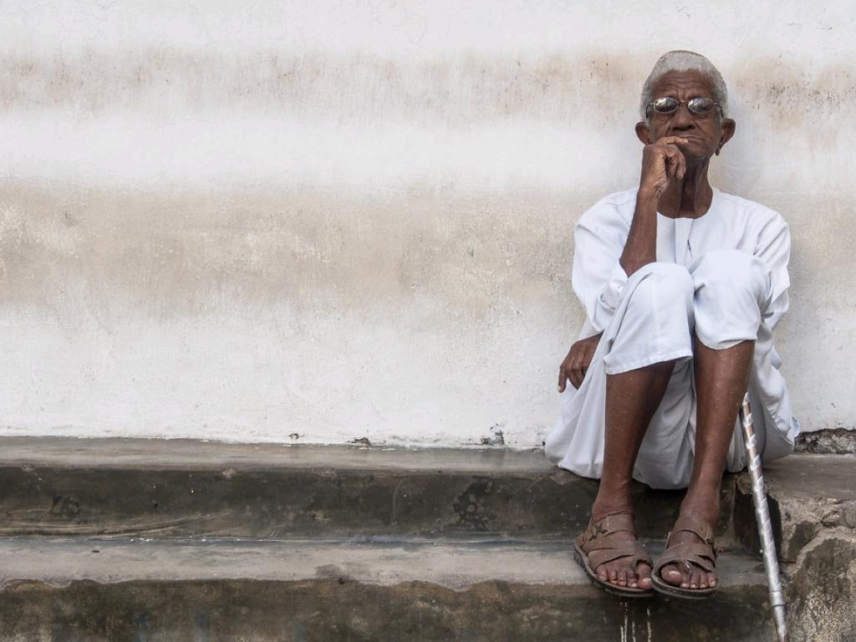
Things to Consider
You don’t have to do it alone
EMPOWER OTHERS
How much is too much?
cc: Georgie Pauwels - https://www.flickr.com/photos/53662163@N06

Slide 16
What have you done?
cc: Paul Gilmore - https://unsplash.com/@pueblovista?utm_source=haikudeck&utm_medium=referral&utm_campaign=api-credit

Slide 17
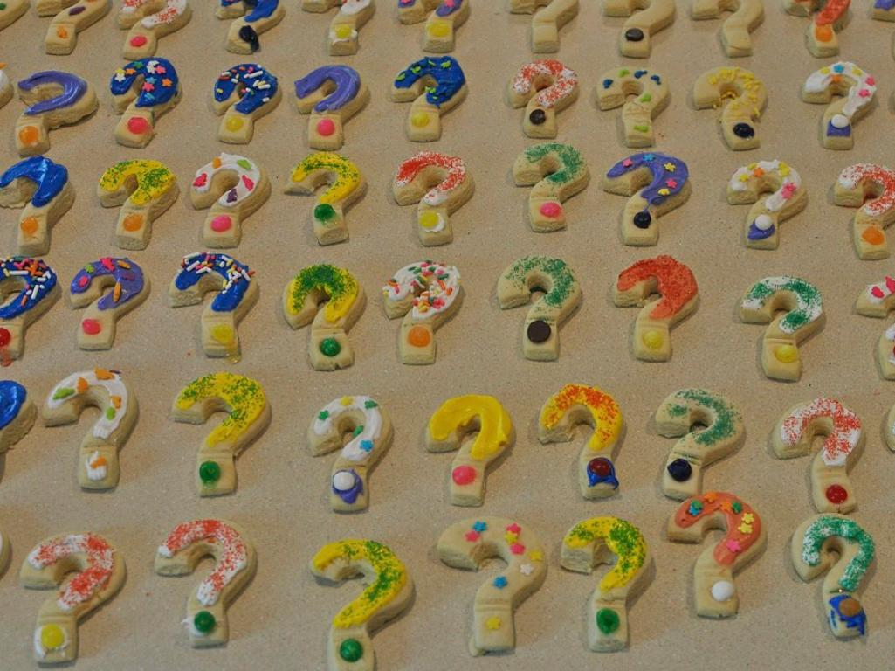
Questions?
cc: Scott McLeod - https://www.flickr.com/photos/93393982@N00

